Slide 1
EDA4SUM: Guided ExploRation of Data Summaries
Brit Youngmann, Sihem Amer-Yahia, Aurélien Personnaz
Literature Review for CS520 (Data Integration, warehousing, and provenance) - fall 2023
Utsav pathak, dhruv dasadia, dharmik dharmesh patel
(group 14)

Slide 2
Abstract
The process of creating understandable and representative subsets from an input dataset is known as data summarization. Typically, it is done in a single step with the aim of obtaining the finest summary.
A valuable synopsis comprises 𝑘 uniform sets that are individually distinct yet collectively varied enough to be representational. Interpretability is addressed by uniformity, and representativity is addressed by diversity. Finding such a summary in vast, extremely different data sets is a challenging undertaking.
They formulate Eda4Sum, which refers to the problem with exploratory data analysis, which aims to progressively construct linked summaries with the purpose of maximizing their cumulative usefulness and investigate the application of Exploratory Data Analysis (EDA) to data summarizing. Eda4Sum extends the concept of one-shot summarizing.
They suggest using one of two methods to solve it: (i) Top1Sum, which selects the most helpful summary at every stage; (ii) RLSum, which uses deep reinforcement learning to train a policy that pays an agent for discovering a fresh and varied set of uniform sets at every stage. We contrast these methods with the best EDA solutions and one-shot summarization.
We conduct in-depth tests using three sizable datasets. Our findings show how effective our methods are at summarizing enormous amounts of data and how important it is to advise subject matter experts.

Slide 3
Introduction
Data Analysis has become an important component of our everyday life, almost everything, right from grocery to our music on spotify to the larger things such as stars and galaxies include analytics. This makes it very necessary to understand the concept of retrieving, collecting and summarizing data.
We take an input dataset and create small (k number) of uniform subsets of the input data (superset). This helps in achieving uniform as well as diverse samples to work with, ensuring not just ease of analytics but also significantly reducing bias that could otherwise occur if the data is not diverse.
The authors mention the Sloan Digital Sky Survey (SDSS) dataset in the paper, the dataset has 169 classes of galaxies (as per the Zoo Classification methodology in astrophysics). This 169 classes, with each galaxy having 7 attributes that describe its unique properties and make a uniform 7 parameters of comparison for the galaxies to be compared to each other and analyze their behavior. An isolated, one-shot SDSS report is not typical. In fact, astronomers nowadays invest a lot of time on querying the SkyServer database using SQL.

Slide 4
Previous Works
One Shot Data Summarization: Summarizing data in a single go: Many different methods have been suggested to summarize data. The authors use the minimum described length as a technique to provide 𝑘 different groups with shared attributes in the data, ways that detect extreme aggregates, and methods that summarize all aggregates are notable examples.
Issues: Data Loss, Assumption
Diversification: In database, search engine, and recommender system query responding, result diversity has been thoroughly investigated. The goal of this task is to deliver 𝑘 solutions that balance utility and variety. Utility is frequently sacrificed in the sake of diversity. Pairwise similarities are a standard method of evaluating variety, which they also used in the investigation. The primary distinction from earlier research is that they take into consideration novelty within itemsets chosen in earlier phases, and that the novelty score may fluctuate during the summarizing process.

Slide 5
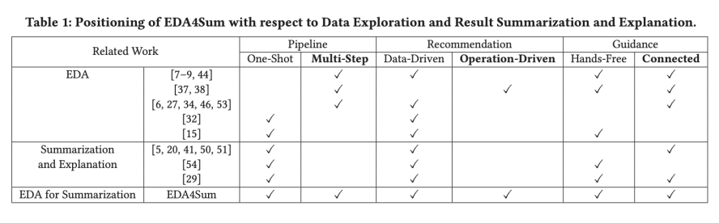
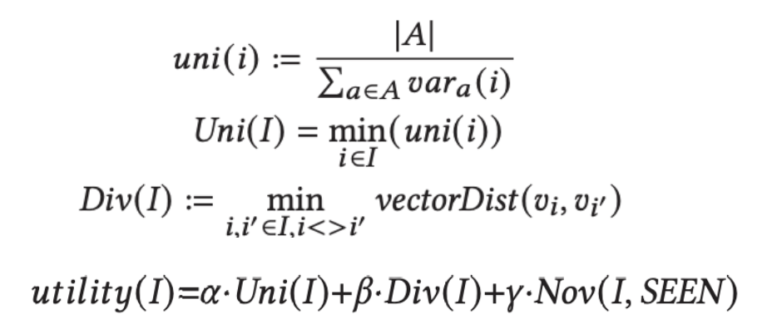
Data MODELS and summaries
They examine a collection of objects 𝐷 that are characterized by a collection of (numerical or categorical) ordinal characteristics 𝐴. They utilize SDSS to demonstrate the data model without sacrificing generality. It is expected that values of numerical attributes are divided into a set number of bins. The values of 𝑑 for each attribute 𝑎∈𝐴 with the vector representation for each item 𝑑∈𝐷, and are denoted as 𝑣𝑑. So, they use the concept of an itemset later on, which is defined as a group of items. With the advantage of quickly expressing the itemset's content, those characteristics constitute the itemset description. D is the collection of all itemsets that were made with 𝐷.
The degree of similarity between items in a summary throughout all of its itemsets is measured by its uniformity. First, we define what an itemset's homogeneity is. Let v(x) be a variance measure, and let y represent variance of items y with respect to an attribute y.

Slide 6
Application of EDA for Summarization of Data
During the offline stage, they initialized a set-based model and preprocessed the data. Every attribute undergoes equi-depth binning, and mining methods such as LCM are utilized to produce itemsets that may overlap. Modified Reinforcement, learning models are trained. They let users create summarizing pipelines online by choosing one of the following modes: manual in which the user enters the following itemset, operation, and matching characteristics to be applied to the selected itemset after the system provides a summary at each stage.
Partial Guidance: In this approach, the user can furnish only a portion of the necessary information for the subsequent step, with the system displaying a summary at each stage.
Under Full Guidance, a 𝑡-size summary pipeline is displayed by the system. Both partial and full advice depend on a summarization pipeline being run.

Slide 7
Top1sum algorithm
At each stage of the summarizing pipeline, the Top1Sum algorithm uses local optimization to identify the operation that yields the highest utility summary. Assuming that the itemset is being viewed currently by the user, Top1Sum automatically looks at every potential next step at each step, i.e., every (itemset, 𝑒𝑥𝑝𝑜𝑟𝑒()), attributes) combination, and performs the step that produces the summary with the highest utility. Formally, at each stage, Top1Sum selects the summary 𝐼 such that the operator used on the itemset 𝑖∈𝐼 that yields the maximum utility across all operators and input itemsets.
For the Eda4Sum Problem, Top1Sum offers no theoretical assurances. However, as demonstrated by their experimental investigation, Top1Sum performs well in real-world scenarios and can produce good results as pipelines. They saw that even when they had the vectors, the primary limitation of Top1Sum is its execution times, which are quite sluggish. To expedite calculation, the next-step summaries' utility computation might be parallelized.

Slide 8
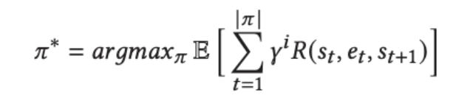
RLSUM ALGORITHM
Without a model they can solve the issue of determining a pipeline, or policy, that maximizes the discounted cumulative reward by using reinforcement learning. Policy gradient techniques combined with a learnt value function are known as actor-critic approaches. Learning agents through the reward function, each learning episode comprises action probabilities and values that are updated on a regular basis. Using the current estimated benefit of doing that action as a basis, the policy (the actor) modifies action probabilities; value function changes this advantage depending on returns.

Slide 9
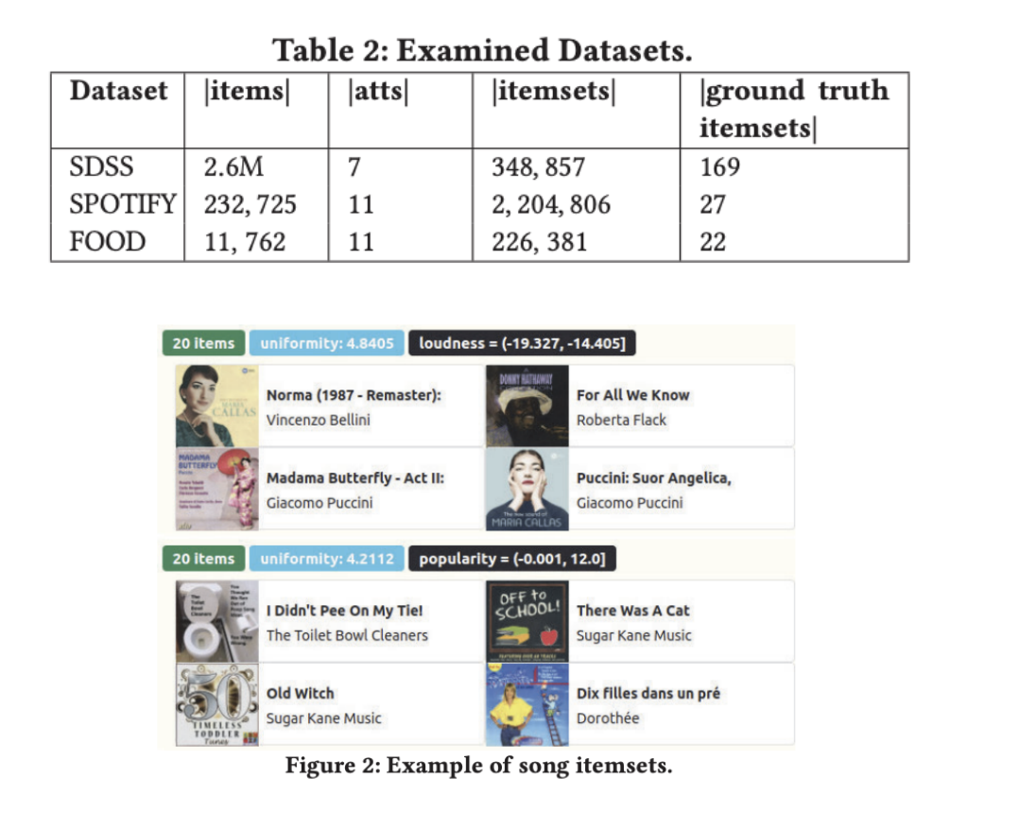
Implementation and Results
The standard deviation metric is how we calculate utility. In the event that some qualities are categorical, we might employ alternative deviation metrics, such entropy, without compromising our solution. As the vector distance measure, we employ the Manhattan distance formula to quantify variety. With relatively slight adjustments, other vector distance measures might be employed.

Slide 10
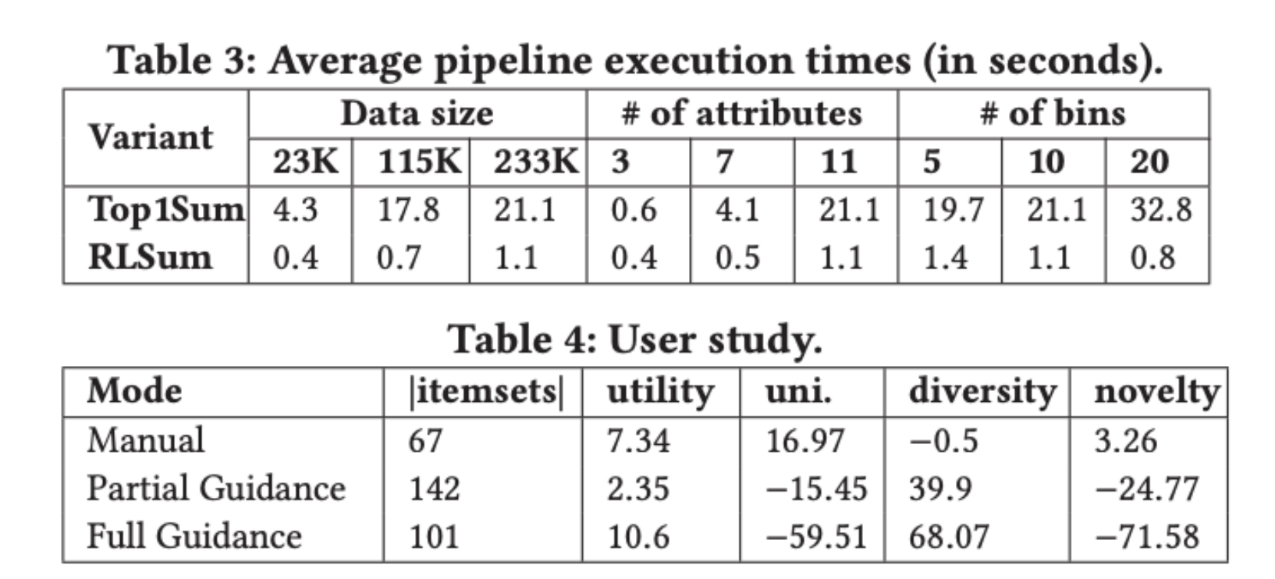
IMPLEMENTATION AND RESULTS (CONTD.)
A summary's uniqueness, diversity, and homogeneity are all trade-offs. It could be more expensive to find a very consistent and varied summary than to return a unique one. The preferences of the user may alter at various stages of the summarizing process. Assume that the user has viewed several itemsets in earlier phases. In this instance, returning a consistent and varied summary is more crucial than a new one. We experimented with two changing weight schemes—increasing novelty and decreasing novelty—to capture this. The length of the pipeline, count of itemsets, and the number of observed itemsets are the functions that determine the novelty weight for these systems. There will be comparisons between this weighing system and others, such fixed-value weights (like balanced weights).

Slide 11
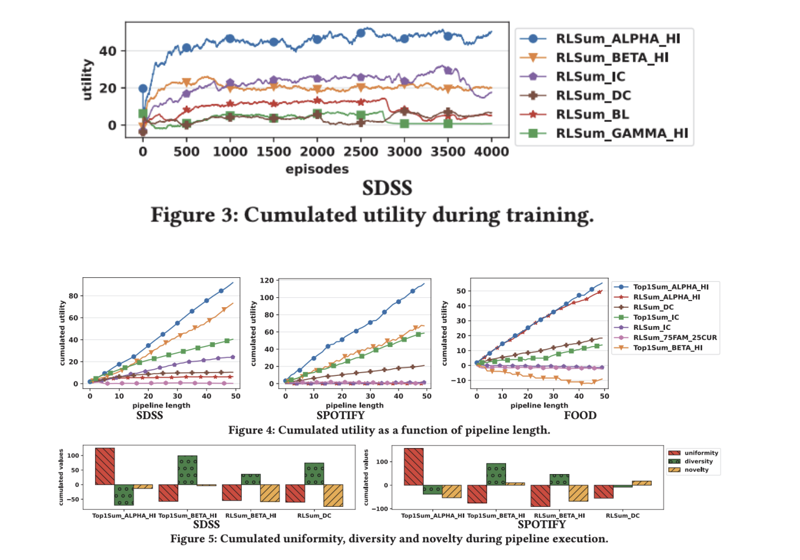
Limitations of the Analysis
A single step's running time is calculated from the moment an operation is selected until a summary is shown. Every pipeline is run under full guidance, and the average of five executions is reported. Results on SPOTIFY are shown in Table 3. The trends were similar in other datasets. Since the EDA variations' running times are identical to those of RLSum, they are excluded. Only two variants—Top1Sum_HU and RLSum_DC—are compared because running times are unaffected by weights. As anticipated, the outcomes unequivocally demonstrate that RLSum performs certain things better than Top1Sum, and that the gap between the two grows as data size, attribute count, and bin count rise.

Slide 12
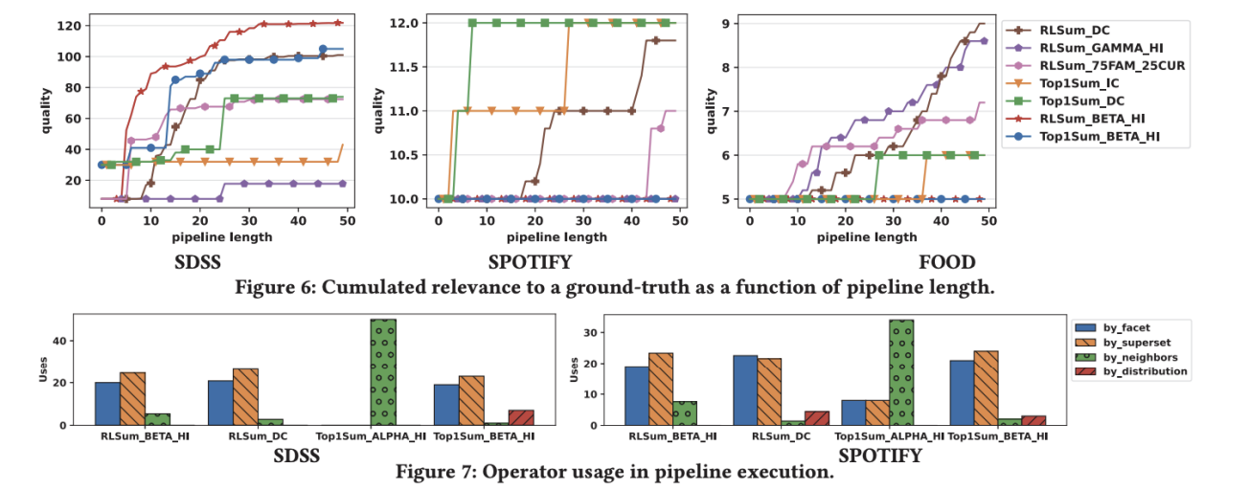
LIMITATIONS (CONTD.)
As Top1Sum compares each itemset to every potential subsequent operator in order to get the greatest utility outcomes, the amount of itemsets that each operator returns determines how long it takes to execute. Execution times rise as the bins grow since more aspects and consequent itemsets are produced. It's interesting to note that while the number of mined itemsets decreases, RLSum's performance increases with more bins. These outcomes demonstrate that RLSum is the recommended technique for interactive summarizing. Given that RLSum requires a lengthy training period, Top1Sum is still a possible preference even if it yields the greatest utility summaries. However, there is a massive scalability issue and issue of high memory and space consumption.

Slide 13
FUTURE SCOPE OF WORK
We need a better understanding of the RLSum and not treat it as a blackbox. We also need to figure out cheaper ways to fund shortest paths to analyze to reduce cost for larger datasets.
Image data and even sound data could be analyzed using quantum modified circuits which could be of great help for images and data from platforms such as spotify. Another addition would be NISQ modifications and quantum circuits to enable more in-depth analysis of images.

Slide 14
REFERENCES
EDA4SUM: Guided Exploration of Data Summaries, Aurélien Personnaz, Brit Youngmann, Sihem Amer-Yahia, Proc. VLDB Endow.15 (12), 3590--3593, 2022. [THE PAPER ITSELF]
Quantum ML Algorithm for Optimizing digital data using Enhanced Quantum Classifier Techniques in Learning Methods P. Mano Paul, Utsav Pathak, Siddhartha Das, Saurabh Kumar, Rakshit Govind T [FUTURE SCOPE OF WORK]

